Slide 1
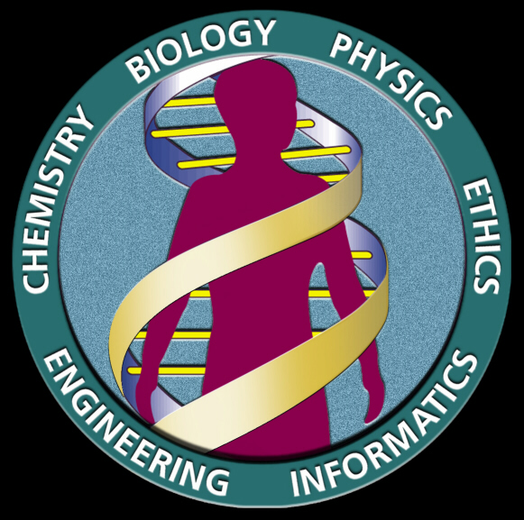
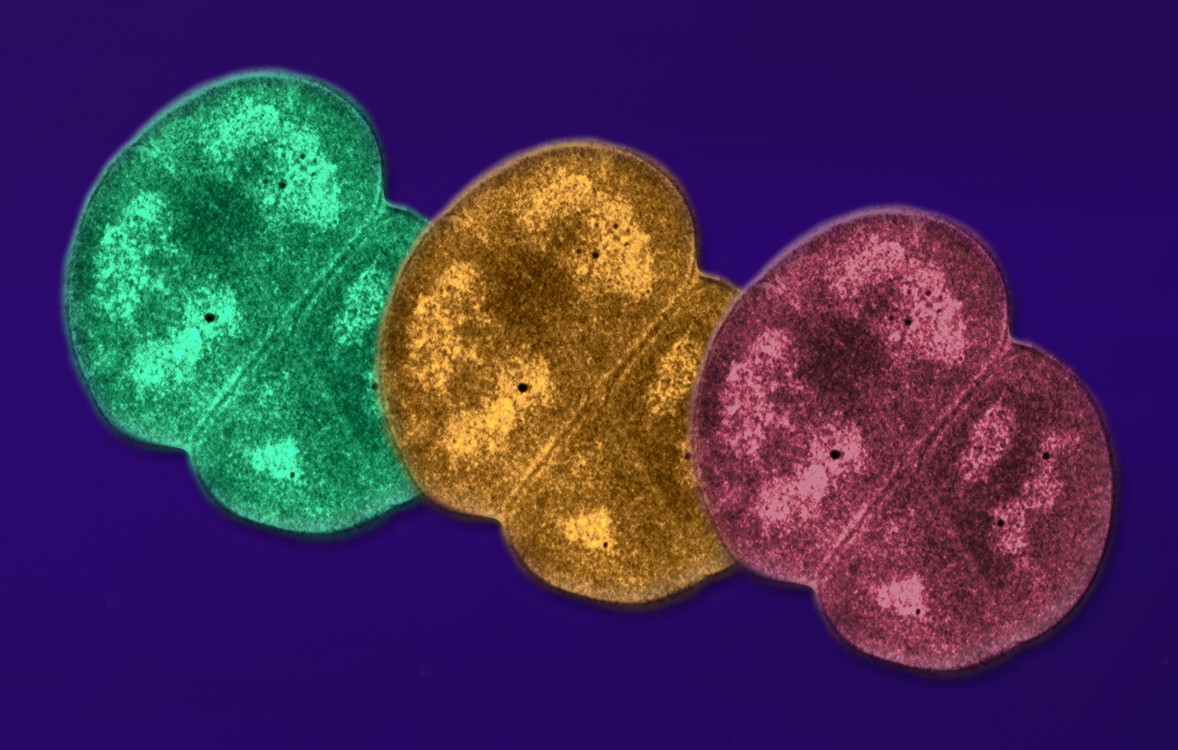
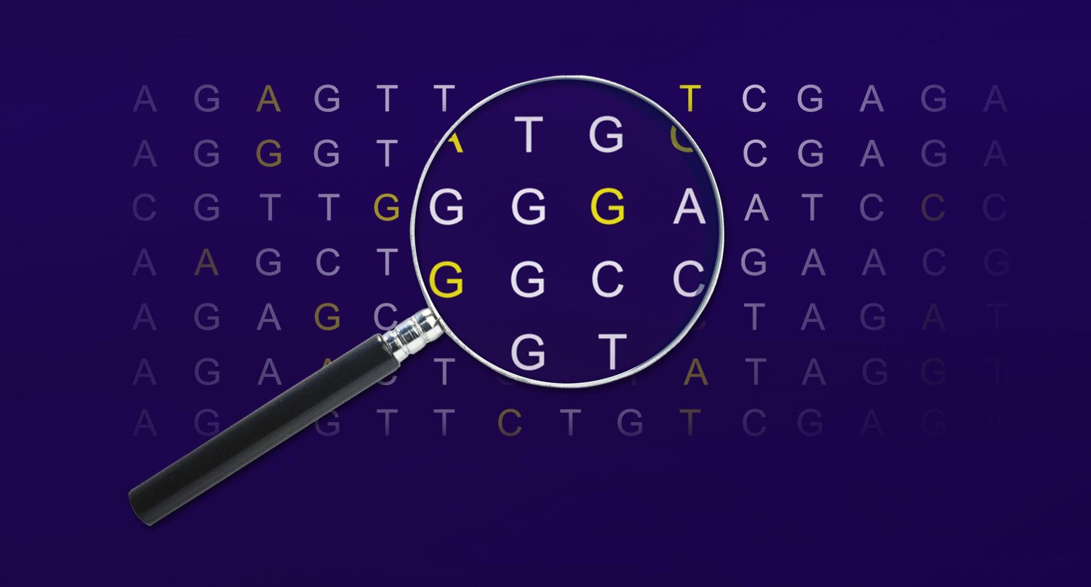
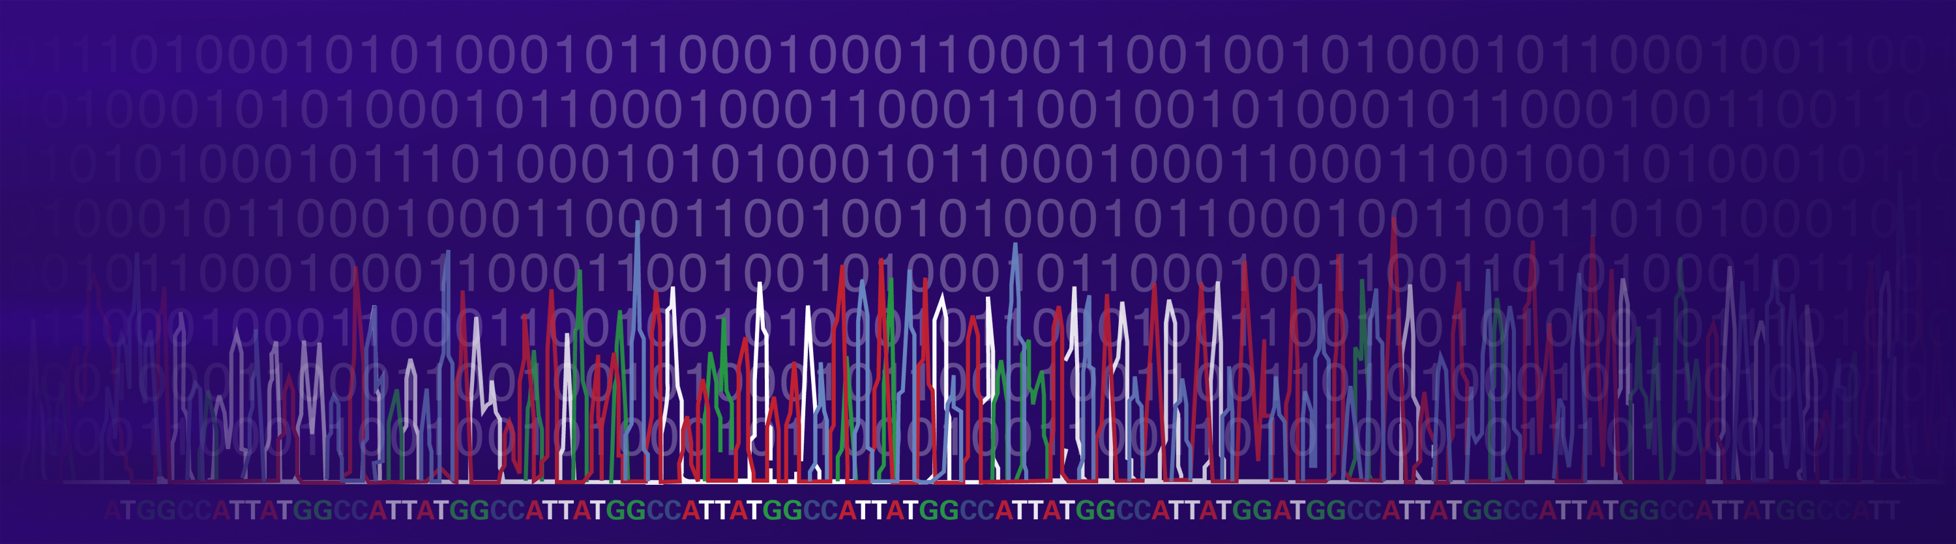
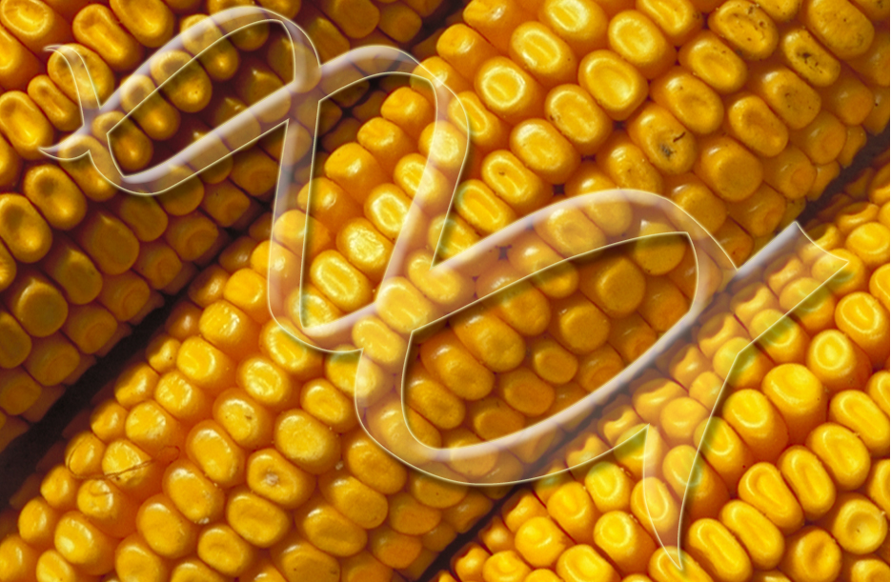
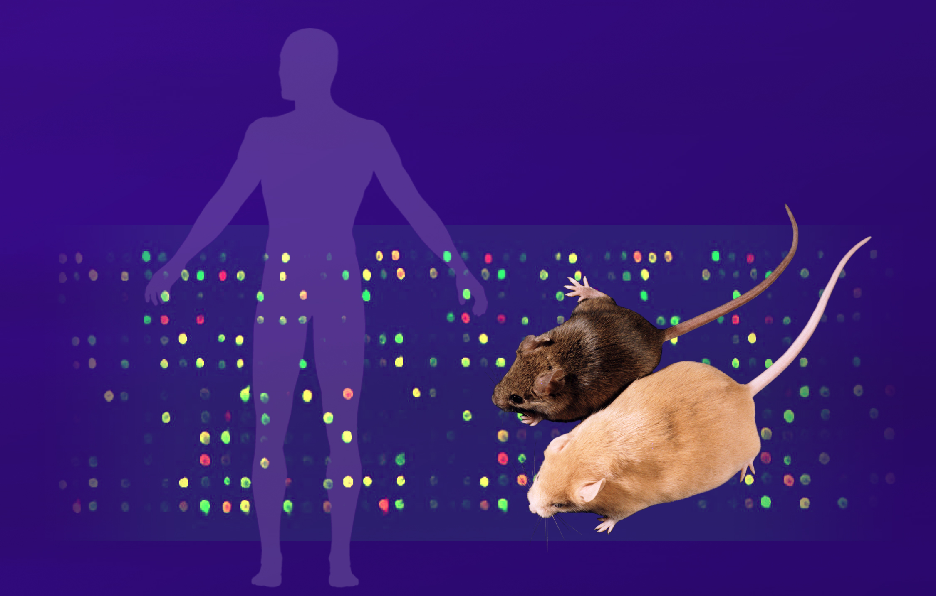
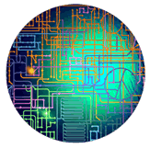
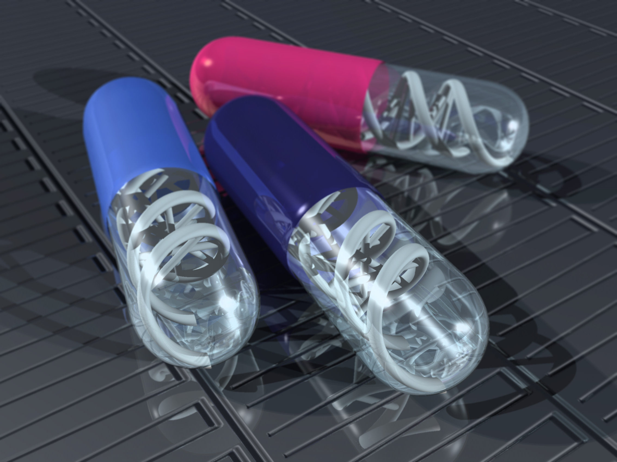
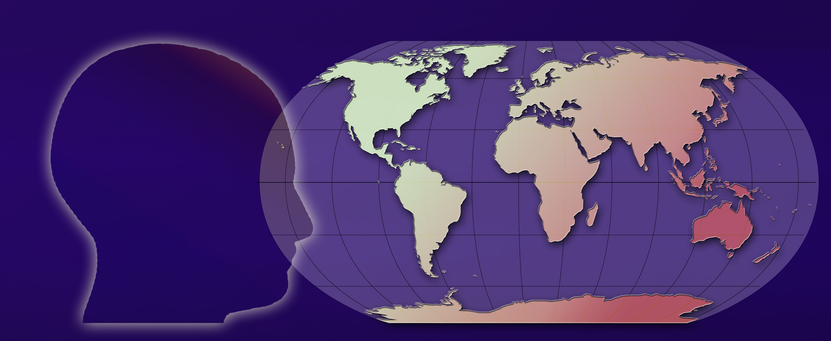
Beyond the Human Genome Project
New Discovery Paths and Diverse Applications

Slide 2
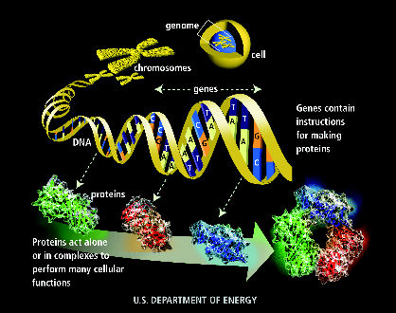

Slide 3
In 2003 scientists in the Human Genome Project obtained the DNA sequence of the 3 billion base pairs making up the human genome

Slide 4
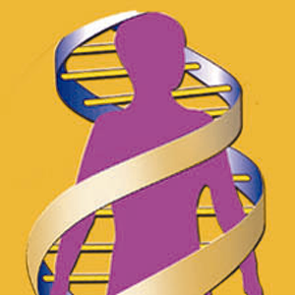
What we’ve learned so far from the Human Genome Project
The human genome is nearly the same (99.9%) in all people
Only about 2% of the human genome contains genes, which are the instructions for making proteins

Slide 5
Other Lessons from the Human Genome Project
Humans have an estimated 30,000 genes; the functions of more than half of them are unknown
Almost half of all human proteins share similarities with other organisms, underscoring the unity of live

Slide 6
Much is still unknown!

Slide 7
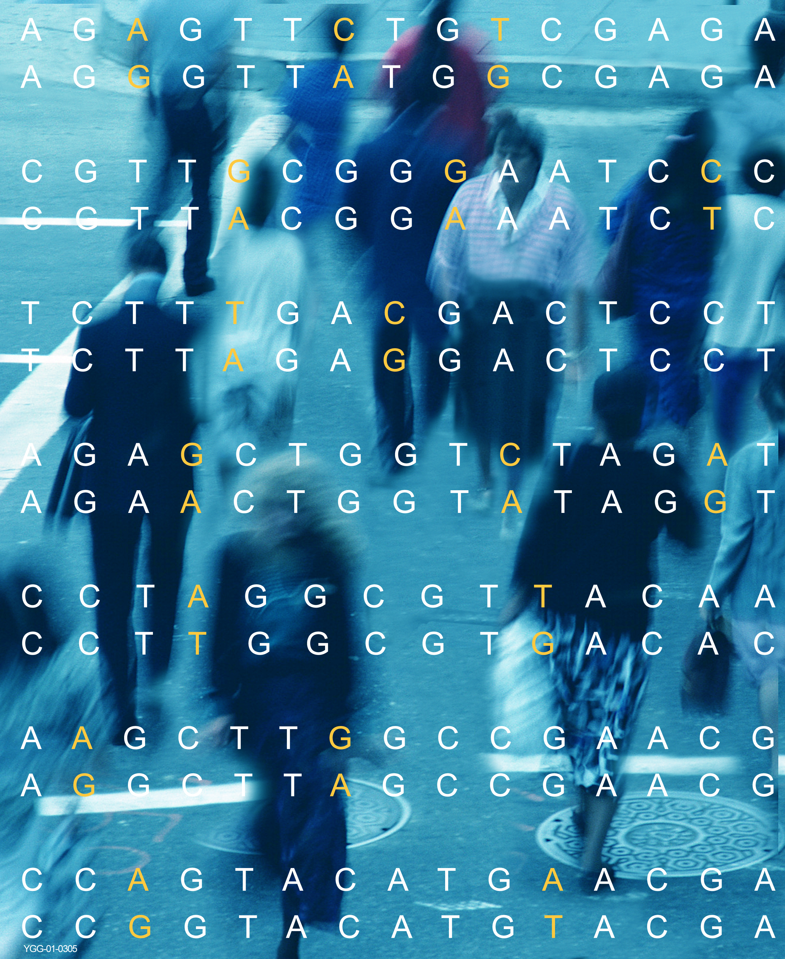
New Scientific Discovery Paths
Enabled by DNA Sequences and Technologies

Slide 8
Scientific Discovery Path
Explore how DNA impacts HEALTH
Identify and understand the differences in DNA sequence (A, T, C, G) among human populations

Slide 9
Scientific Discovery Path
Understand what all the GENES do
Discover the functions of human genes by experimentation and by finding genes with similar functions in the mouse, yeast, fruit fly, and other sequenced organisms

Slide 10
Scientific Discovery Path
Learn what the rest of the
human genome does
Identify important elements in the nongene regions of DNA that are present in many different organisms, including humans

Slide 11
Scientific Discovery Path
Understand how the genome enables life
Explore life at the ultimate level of the whole organism instead of single genes or proteins.
The DOE Genomes to Life program provides a foundation for this understanding by using the information found in the genomes of microbes, life’s simplest organisms, to study how proteins—the products of genes—carry out all activities of living cells.

Slide 12
Diverse Applications
of DNA Data and Technologies
Medicine Energy Environment Agriculture Identification Bioanthropology

Slide 13
Diverse Applications
Medicine
Develop more accurate and rapid diagnostics
Design customized treatments

Slide 14
Diverse Applications
Microbes for energy and the environment
Microbes thrive in every environment on earth, but the vast majority DO NOT cause disease. Understanding them at a basic level will enable use of their diverse and sophisticated abilities.
Clean up toxic wastes
Capture excess carbon to help reduce global climate change
Generate clean energy sources
(e.g., hydrogen)

Slide 15
Diverse Applications
Bioanthropology
Understand human lineage
Explore migration patterns through time

Slide 16
Diverse Applications
agriculture, livestock breeding, bioprocessing
Make crops and animals more resistant to diseases, pests, and environmental conditions
Grow more nutritious and abundant produce
Incorporate vaccines into food products
Develop more efficient industrial processes

Slide 17
Diverse Applications
DNA identification
Identify kinships, catastrophe victims
Exonerate or implicate people accused of crimes
Identify contaminants in air, water, soil, food
Confirm pedigrees of animals, plants, foods, wines

Slide 18
This presentation is a companion to the BEYOND THE HUMAN GENOME PROJECT poster produced by the U.S. Department of Energy Human Genome Program
Free copies available
www.ornl.gov/hgmis/posters/beyondhgp/
2003. Human Genome Management Information System, Oak Ridge National Laboratory, Oak Ridge, TN; millsmd@ornl.gov, 865-574-0597

